Slide 1
Simple ALU
Half adder
Full adder
Constructing 4 bits adder
ALU does several operations
General ALU structure
Timing diagram of adder
Overflow logic
Texbook P&H. Chapter 4.5

Slide 2
Adding 2 bits
A key requirement of digital computers is:
the ability to use logical functions to perform arithmetic operations.
We start the construction of ALU from simple 2 bit adder.
To create the 2 bit adder first the truth table for it should be created. We can derive the truth table from below addition table.
0 + 0 = 0
0 + 1 = 1
1 + 0 = 1
1 + 1 = 10

Slide 3
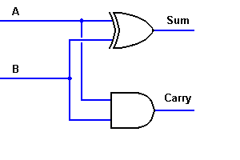
2 bit adder
INPUTS |  | OUTPUTS
A | B | CARRY | SUM
0 | 0 | 0 | 0
0 | 1 | 0 | 1
1 | 0 | 0 | 1
1 | 1 | 1 | 0
The Carry output is a simple AND function
Sum is an Exclusive-OR.
Sum = A’B + AB’ = A ⊕ B
Carry = AB
this circuit is known as a "half adder," because it only does half of the job
it must also be able to recognize and include a carry from the next lower order of magnitude
Thus, we can use two gates to add these two bits together.

Slide 4
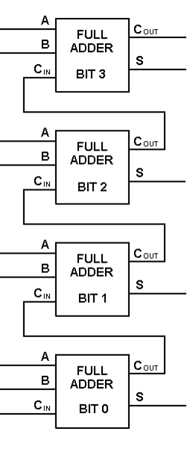
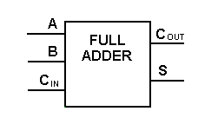
Full adder. 4 bit pairs full adder.
To add two 4-bit numbers to produce a 4-bit sum (with a possible carry), you would need 4 full adders with carry lines cascaded, as shown to the right.
Take the possible carry from the next lower order of magnitude, and send a carry to the next higher order of magnitude

Slide 5
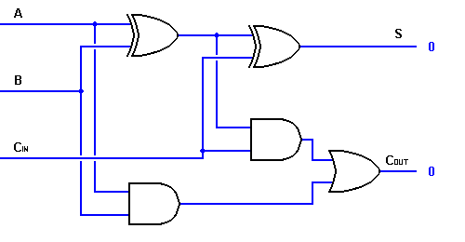
3 inputs Full Adder
To construct a full adder circuit, we'll need three inputs and two outputs.
INPUTS |  |  | OUTPUTS
A | B | C_{IN} | C_{OUT} | Sum
0 | 0 | 0 | 0 | 0
0 | 0 | 1 | 0 | 1
0 | 1 | 0 | 0 | 1
0 | 1 | 1 | 1 | 0
1 | 0 | 0 | 0 | 1
1 | 0 | 1 | 1 | 0
1 | 1 | 0 | 1 | 0
1 | 1 | 1 | 1 | 1
S = A’B’C_{in}+ A’BC_{in}’ + AB’C_{in}’ + ABC_{in} = C_{in}(A’B’ + AB) + C_{in}’ (AB’+ A’B) = C_{in}(A’B’ + AB)’’ + C_{in}’ (AB’+ A’B) = C_{in}(A ⊕ B)’ + C_{in}’ (A ⊕ B) = (A ⊕ B) ⊕ C_{in}
C_{out} = A’BC_{in}+ AB’C_{in} + ABC_{in}’ + ABC_{in} = C_{in}(A’B + AB’) + AB (C_{in} + C_{in}’) = C_{in}(A’B + AB’) + AB (1) = C_{in}(A ⊕ B) + AB

Slide 6
Logical operations of ALU
The logical operations are easiest, because they map directly onto the hardware components.
The multiplexor selects a AND b or a OR b, depending on whether the value of Operation is 0 or 1.
Notice that we have renamed the control and output lines of the multiplexor to give them names that reflect the function of the ALU.

Slide 7
Additional operations of ALU
The easiest way to add an operation is to expand the multiplexor controlled by the Operation line
A 1-bit ALU that performs AND, OR, and addition

Slide 8
More operations of ALU
A 1-bit ALU that performs AND, OR, and addition on a and b or a and b’
By selecting b’ (Binvert = 1) and setting Carry In to 1 in the least significant bit of the ALU, we get two’s complement subtraction of b from a instead of addition of b to a.

Slide 9
General ALU structure

Slide 10
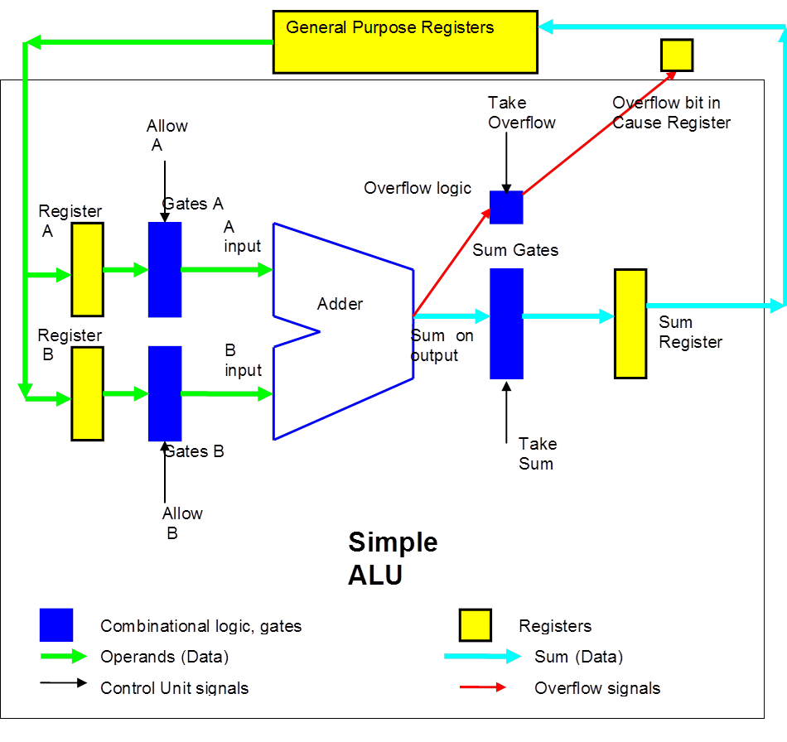
ALU on gates

Slide 11
Overflow detection circuits

Slide 12
Overflow circuit
Y=a’bc + ab’c = c (a’b+ab’)

